Slide 1
Brute Force
Unit 2

Slide 2


Slide 3
What is Brute Force?
Brute Force is a straightforward approach to solving a problem, usually directly based on the problem statement and definitions of the concepts involved.

Slide 4
BRUTE FORCE SORTING ALGORITHMS

Slide 5
Selection Sort – Idea
Scan the array to find its smallest element and swap it with the first element.
Then, starting with the second element, scan the elements to the right of it to find the smallest among them and swap it with the second element.
Generally, on pass i (0 ≤ i ≤ n-2), find the smallest element in A[i..n-1] and swap it with A[i ]
A[0] ≤ A[1] ≤ A[2] … ≤ A[i-1] | A[i+1], ….., A[min], …., A[n-1]
in their final positions the last n – i elements

Slide 7
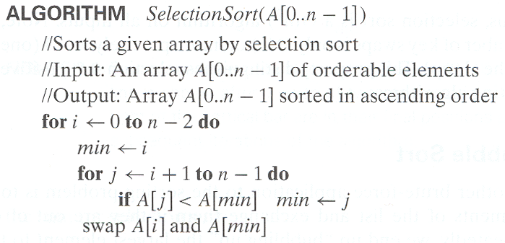
Selection Sort - Algorithm

Slide 8
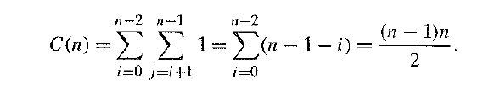
Selection Sort - Analysis
Selection Sort is a Θ(n²) algorithm

Slide 9
Bubble Sort – Idea
Compare adjacent elements of the list and exchange them if they are out of order.
By doing it repeatedly, we end up bubbling the largest element to the last position on the list.
The next pass bubbles up the second largest element and so on and after n – 1 passes, the list is sorted.
Pass i (0 ≤ i ≤ n – 2) can be represented as follows:
A[0], A[1], A[2], …, A[j] A[j+1], …, A[n-i-1] | A[n-i] ≤ …. ≤ A[n-1]

Slide 11
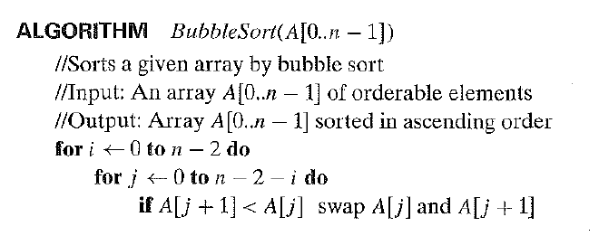
Bubble Sort - Algorithm

Slide 12
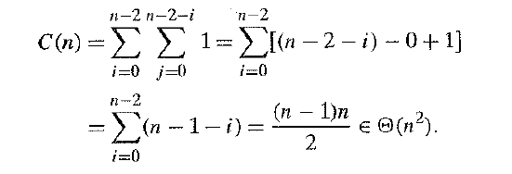
Bubble Sort - Analysis
Bubble Sort is a Θ(n²) algorithm

Slide 13
SEQUENTIAL SEARCH

Slide 14
Sequential Search – Idea
Compares successive elements of a given list with a given search key until:
A match is encountered (Successful Search)
List is exhausted without finding a match (Unsuccessful Search)
An improvisation to the algorithm is to append the key to the end of the list.
This means the search has to be successful always and we can eliminate the end of list check.

Slide 16
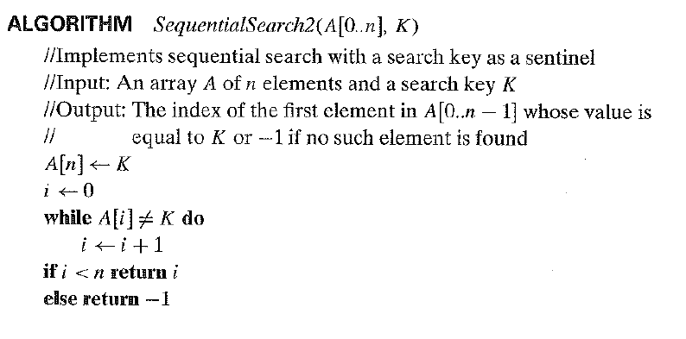
Sequential Search - Algorithm

Slide 17
Sequential Search - Analysis
Sequential Search is a Θ(n) algorithm

Slide 18
BRUTE – FORCE STRING MATCHING

Slide 19
String Matching – Terms
pattern:
a string of m characters to search for
text:
a (longer) string of n characters to search in
problem:
find a substring in the text that matches the pattern

Slide 20
String Matching – Idea
Step 1 Align pattern at beginning of text
Step 2 Moving from left to right, compare each character of pattern to the corresponding character in text until:
all characters are found to match (successful search); or
a mismatch is detected
Step 3 While pattern is not found and the text is not yet exhausted, realign pattern one position to the right and repeat Step 2

Slide 21
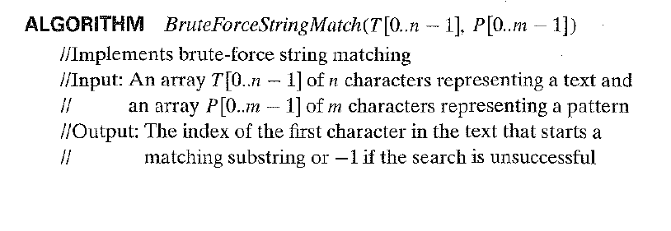
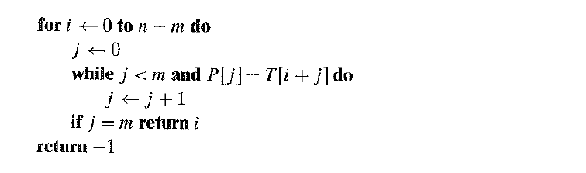
String Matching - Algorithm

Slide 22
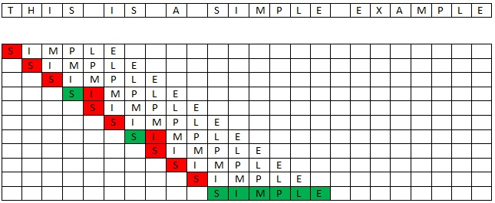

Slide 23
String Matching - Analysis
Worst Case:
The algorithm might have to make all the ‘m’ comparisons for each of the (n-m+1) tries.
Therefore, the algorithm makes m(n-m+1) comparisons.
Brute Force String Matching is a O(nm) algorithm

Slide 24
EXHAUSTIVE SEARCH

Slide 25
What is Exhaustive Search?
Exhaustive Search is a brute – force problem solving technique
It suggests generating each and every element of the problem domain, selecting those of them that satisfy all the constraints and then finding a desired element.
The desired element might be one which minimizes or maximizes a certain characteristic.
Typically the problem domain involves combinatorial objects such as permutations, combinations and subsets of a given set.

Slide 26
Exhaustive Search - Method
Generate a list of all potential solutions to the problem in a systematic manner
Evaluate potential solutions one by one, disqualifying infeasible ones and, for an optimization problem, keeping track of the best one found so far
When search ends, announce the solution(s) found

Slide 27
TRAVELING SALESMAN PROBLEM

Slide 28
The Problem
Given a list of cities and the distances between each pair of cities, what is the shortest possible route that visits each city and returns to the origin city?
Alternative way to state the problem:
Find the shortest Hamiltonian Circuit in a weighted connected graph.

Slide 29
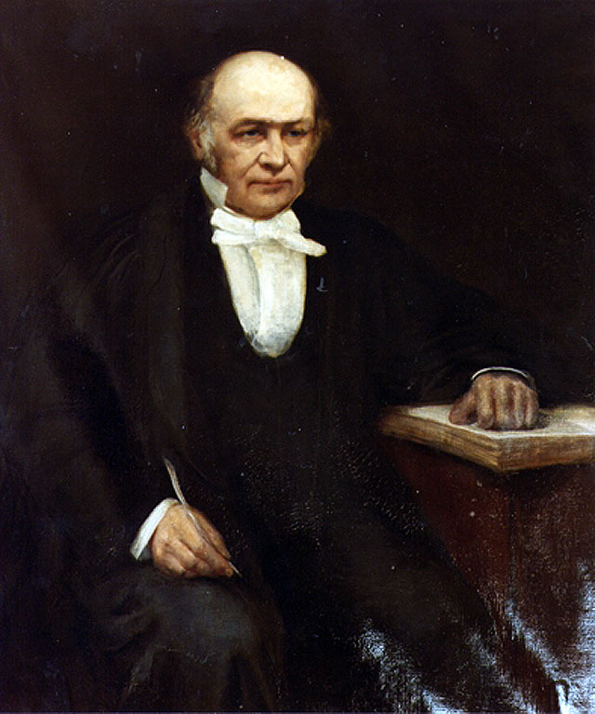
History and Relevance
The Travelling Salesman Problem was mathematically formulated by Irish Mathematician Sir William Rowan Hamilton.
It is one of the most intensively studied problems in optimization
It has applications in logistics and planning.

Slide 30
Example
Tour | Length
a→b→c→d→a | 2+3+7+5 = 17
a→b→d→c→a | 2+4+7+8 = 21
a→c→b→d→a | 8+3+4+5 = 20
a→c→d→b→a | 8+7+4+2 = 21
a→d→b→c→a | 5+4+3+8 = 20
a→d→c→b→a | 5+7+3+2 = 17
a
2
b
5
3
8
4
c
d
7

Slide 31
Efficiency
The Exhaustive Search solution to the Travelling Salesman problem can be obtained by keeping the origin city constant and generating permutations of all the other n – 1 cities.
Thus, the total number of permutations needed will be (n – 1)!

Slide 32
KNAPSACK PROBLEM

Slide 33
The Problem
Given n items:
weights: w₁ w₂ … w_{n}
values: v₁ v₂ … v_{n}
a knapsack of capacity W
Find the most valuable subset of items that fit into the knapsack

Slide 34
Example
Knapsack Capacity W = 16
Item | Weight | Value
1 | 2 | 20
2 | 5 | 30
3 | 10 | 50
4 | 5 | 10

Slide 35
Subset | Total Weight | Total Value
{1} | 2 | 20
{2} | 5 | 30
{3} | 10 | 50
{4} | 5 | 10
{1, 2} | 7 | 50
{1, 3} | 12 | 70
{1, 4} | 7 | 30
{2, 3} | 15 | 80
{2, 4} | 10 | 40
{3, 4} | 15 | 60
{1, 2, 3} | 17 | Not Feasible
{1, 2, 4} | 12 | 60
{1, 3, 4} | 17 | Not Feasible
{2, 3, 4} | 20 | Not Feasible
{1, 2, 3, 4} | 22 | Not Feasible
Knapsack Problem by Exhaustive Search

Slide 36
Efficiency
The Exhaustive Search solution to the Knapsack Problem is obtained by generating all subsets of the set of n items given and computing the total weight of each subset in order to identify the feasible subsets,
The number of subsets for a set of n elements is 2^{n}.
The Exhaustive Search solution to the Knapsack Problem belongs to Ω(2^{n}).
The Exhaustive Search solution to the Knapsack Problem belongs to Ω(2^{n}).

Slide 37
THE ASSIGNMENT PROBLEM

Slide 38
The Problem
There are n people who need to be assigned to n jobs, one person per job. The cost of assigning person i to job j is C[i, j]. Find an assignment that minimizes the total cost.

Slide 39
Example
 | Job 1 | Job 2 | Job 3 | Job 4
Person 1 | 9 | 2 | 7 | 8
Person 2 | 6 | 4 | 3 | 7
Person 3 | 5 | 8 | 1 | 8
Person 4 | 7 | 6 | 9 | 4

Slide 40
Algorithmic Plan
Generate all legitimate assignments
Compute their costs
Select the cheapest one

Slide 41
Assignment | Cost
1, 2, 3, 4 | 9 + 4 + 1 + 4 = 18
1, 3, 4, 2 | 9 + 8 + 9 + 7 = 33
1, 4, 3, 2 | 9 + 6 + 1 + 7 = 23
1, 4, 2, 3 | 9 + 6 + 3 + 8 = 26
1, 3, 2, 4 | 9 + 8 + 3 + 4 = 24
1, 2, 4, 3 | 9 + 4 + 9 + 8 = 30
The Assignment Problem by Exhaustive Search
Etc.

Slide 42
Efficiency
The Assignment Problem is solved by generating all permutations of n.
The number of permutations for a given number n is n!
Therefore, the exhaustive search is impractical for all but very small instances of the problem.

